Slide 1

Lesson 2.5: Boolean Expressions and Operators
Microsoft Philanthropies TEALS Program
Introduction to Computer Science

Slide 2
After this lesson, you will be able to
Define and identify Boolean expressions and operators
Evaluate Boolean expressions
Utilize Boolean operators (and/or/not) to create compound conditions

Slide 3
Today’s Plan
Do Now
Lecture
Lab
Debrief

Slide 4

Do Now 2.5
Write an algorithm, in English, for how you would swap the values in two variables.
For example, suppose we have two variables that have different values :
set [playerOneValue] to "Torch“
set [playerTwoValue] to "Gold“
How would you swap the values so that
[playerOneValue] is set to "Gold" and
[playerTwoValue] is set to "Torch"?
Here, "Torch" and "Gold" are just examples -- suppose the algorithm doesn't know what values the variables have before it begins.
Swap your algorithm with a partner and test it to determine if it works or not.
Notes:
https://tealsk12.gitbook.io/intro-cs/unit_2/lesson_25/do_now_25
Quickly review student answers

Slide 5



2.5 Lecture: Review Conditionals
Notes:
Remind students that in SNAP, blocks fit together based on shape.
Any of the “pointy” blocks can be used to fill in the if statements.

Slide 6

2.5 Lecture: Booleans
Boolean expressions as expressions that evaluate to true or false
Notes:
https://tealsk12.gitbook.io/intro-cs/unit_2/lesson_25#2-lecture
Introduce Booleans with the "Stand Up, Sit Down:" Warm Up activity of the Code.org "Booleans Unplugged" lesson
Define Boolean expressions as expressions that evaluate to true or false
If desired, explain that the term "Boolean" is derived from George Boole
In Snap!, all Boolean expressions are pointy six-sided blocks
Video on Booleans - https://youtu.be/_j9nvYKaOVE
Note: the blocks used in this video look slightly different than Snap! but they are aligned well enough to give a good introduction to Booleans.
Make sure to talk about the Not operator and how that might work wi

Slide 7
2.5 Lecture: Booleans
Logical Operators:
And: if both conditions are true, the expression is true
Or: if either condition is true, the expression is true
Not: if the condition is false, the expression is true
Notes:
Explain to students the difference between each of the logical operators. This gives them the ability to combine conditionals.
For example,
if a number is greater than 1 and less than 10.
If a number is less than 5 or greater then 10.
If a number is not = to 10

Slide 8
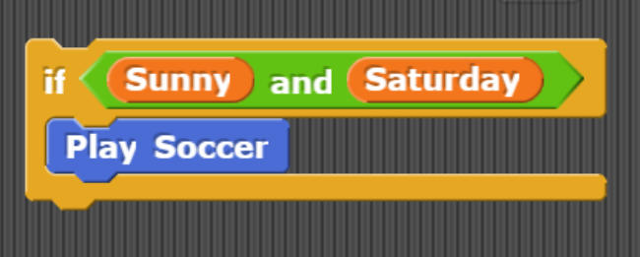
2.5 Lecture: Booleans – AND
Can you play soccer on a sunny Saturday? (sunny = true, Saturday = true)
Can you play soccer on a rainy Saturday? (sunny = false, Saturday = true)
Can you play soccer on a rainy Monday? (sunny = false, Saturday = false)
Notes:
Have a student explain to the class what this expression means.
After presenting each condition have students give you a thumbs up/ 1 in the chat (true) or a thumbs down/ 0 in the chat (false) for each of these questions

Slide 9
2.5 Lecture: Booleans – AND Truth Tables
Is it Sunny? | Is it Saturday | Is it sunny AND Saturday?
True | True | True
True | False | False
False | True | False
False | False | False
Notes:
Truth tables are simply one way of expressing how the Boolean operators work; if students are struggling, other depictions (such as an exhaustive list of all possible results) can be substituted

Slide 10
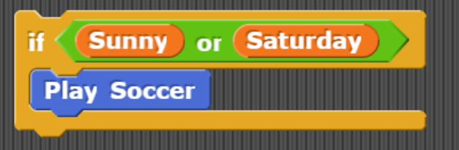
2.5 Lecture: Booleans – OR
Can you play soccer on a sunny Saturday? (sunny = true, Saturday = true)
Can you play soccer on a rainy Saturday? (sunny = false, Saturday = true)
Can you play soccer on a rainy Monday? (sunny = false, Saturday = false)
Notes:
Have a student explain to the class what this expression means.
After presenting each condition have students give you a thumbs up/ 1 in the chat (true) or a thumbs down/ 0 in the chat (false) for each of these questions

Slide 11
2.5 Lecture: Booleans – OR Truth Tables
Is it Sunny? | Is it Saturday | Is it sunny OR Saturday?
True | True | True
True | False | True
False | True | True
False | False | False

Slide 12
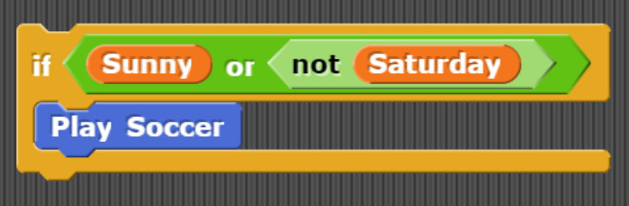
2.5 Lecture: Booleans - NOT
Can you play soccer on a sunny Saturday? (sunny = true, Saturday = true)
Can you play soccer on a rainy Saturday? (sunny = false, Saturday = true)
Can you play soccer on a rainy Monday? (sunny = false, Saturday = false)
Notes:
Have a student explain to the class what this expression means.
After presenting each condition have students give you a thumbs up/ 1 in the chat (true) or a thumbs down/ 0 in the chat (false) for each of these questions

Slide 13
2.5 Lecture: Booleans – NOT Truth Tables
Is it Sunny? | Is it Saturday | Is it NOT Saturday? | Is it sunny OR NOT Saturday?
True | True | False | True
True | False | True | True
False | True | False | False
False | False | True | True

Slide 14
2.5 Lecture: Booleans – Practice
(5 < 7) AND (4 > 2)
Notes:
Encourage students to get into the habit of writing down their thought process.
Given think time, have students share their answer with a partner.
Have students give you a thumbs up/ 1 in the chat (true) or a thumbs down/ 0 in the chat (false).
Call on a student to share their thinking.

Slide 15
2.5 Lecture: Booleans – Practice
x = 7; (x < 5) OR (x > 10)
Notes:
Given think time, have students share their answer with a partner.
Have students give you a thumbs up/ 1 in the chat (true) or a thumbs down/ 0 in the chat (false).
Call on a student to share their thinking.

Slide 16
2.5 Lecture: Booleans – Practice
x = 4
y = -3
(x == y) OR ((x > 0) AND (y < 0)))
Notes:
Underline is there to help students understand the problem.
Given think time, have students share their answer with a partner.
Have students give you a thumbs up/ 1 in the chat (true) or a thumbs down/ 0 in the chat (false).
Call on a student to share their thinking.

Slide 17

Lab 2.5: Triangles of All Kinds
In this lab, you will use Boolean operators to determine what sort of triangle a user is describing. Write a SNAP program that asks the user for the lengths of all three sides of a triangle. Store each length in a variable. Then say the perimeter of the triangle with those three side lengths
Notes:
https://tealsk12.gitbook.io/intro-cs/unit_2/lesson_25#3-activity
Students should complete the "Triangles of All Kinds" activity individually or in diverse pairs (students who have not interacted previously, by ability, etc.)
Several geometric concepts (Triangle Inequality Theorem, Pythagorean Theorem, etc.) are used in this lab, but students need not have a deep understanding of them. The necessary points are explained in the lab.
Encourage students to think about whether an "and" or an "or" is appropriate in each case. Draw out truth tables if necessary.
As done previously in the unit, you can make the Geometry Cheatsheet available to students.

Slide 18

2.5: Debrief
Notes:
Walk through a student's response
Point out uses of Boolean operators
Discuss how nested or chained if blocks could potentially be used to obtain the same behavior, but would result in longer, less-readable code

Slide 19

Exit Ticket
In your notebook, create a real world conditional and write out its truth table

